Slide 1
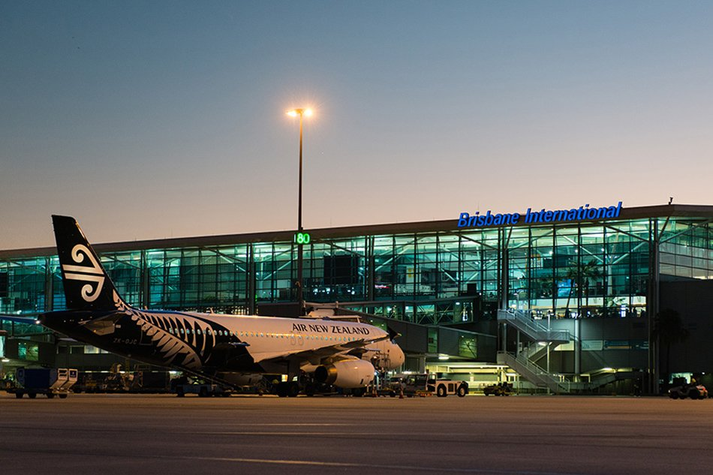
Airport Management System
By : Yashaswi Singh Mansi Agrawal Akhilesh Ghadge Sushan Sheregar

Slide 2
Overview
Problem Specification
The objective of this system is to build an airport management system which can work globally for an airport located in any city in any part of the world. The system will provide a broad overview of the underlying factors that determines the operation of an airport.
Data of all commercial flights which operates in the airport, either through their office which can be located inside the airport or just for commutation purposes
Every airport and airlines is identified by IATA with a unique code. This unique code will help in retrieving a passengers travel information.
Airports will contain their own employee databases with specific work responsibilities
Airlines will have different flight routes, which will have arrival and departure timing along with different travel segments like, Economy, Business and First Class
A passenger flying using an airline or multiple airlines would have a unique identifier alphanumeric code (Confirmation Number/PNR) which would contain information about the passenger.
A ticket will contain all the above listed information like arrival and departure timing, passenger name and id, airlines information and departure and destination location

Slide 3
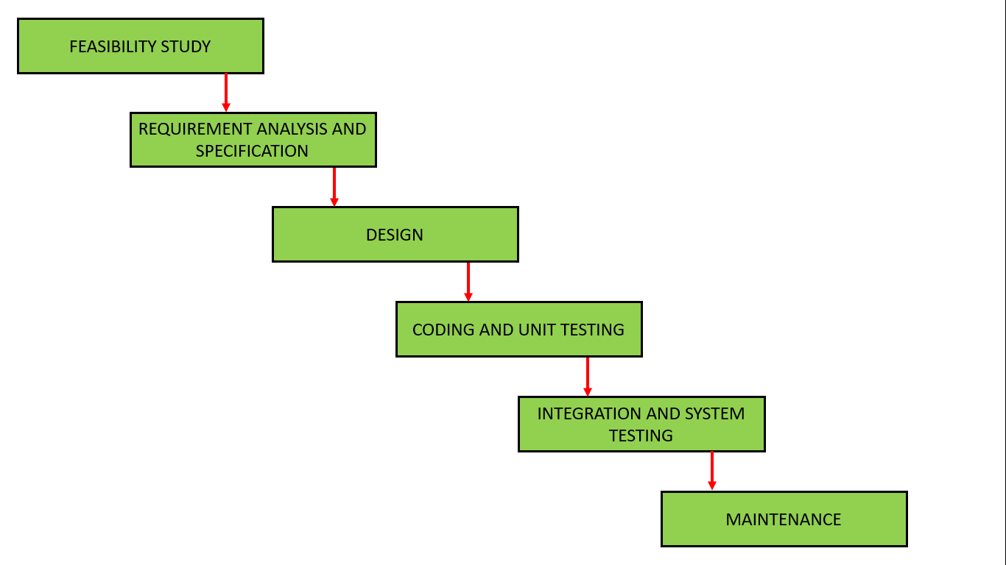
High - Level Design

Slide 4
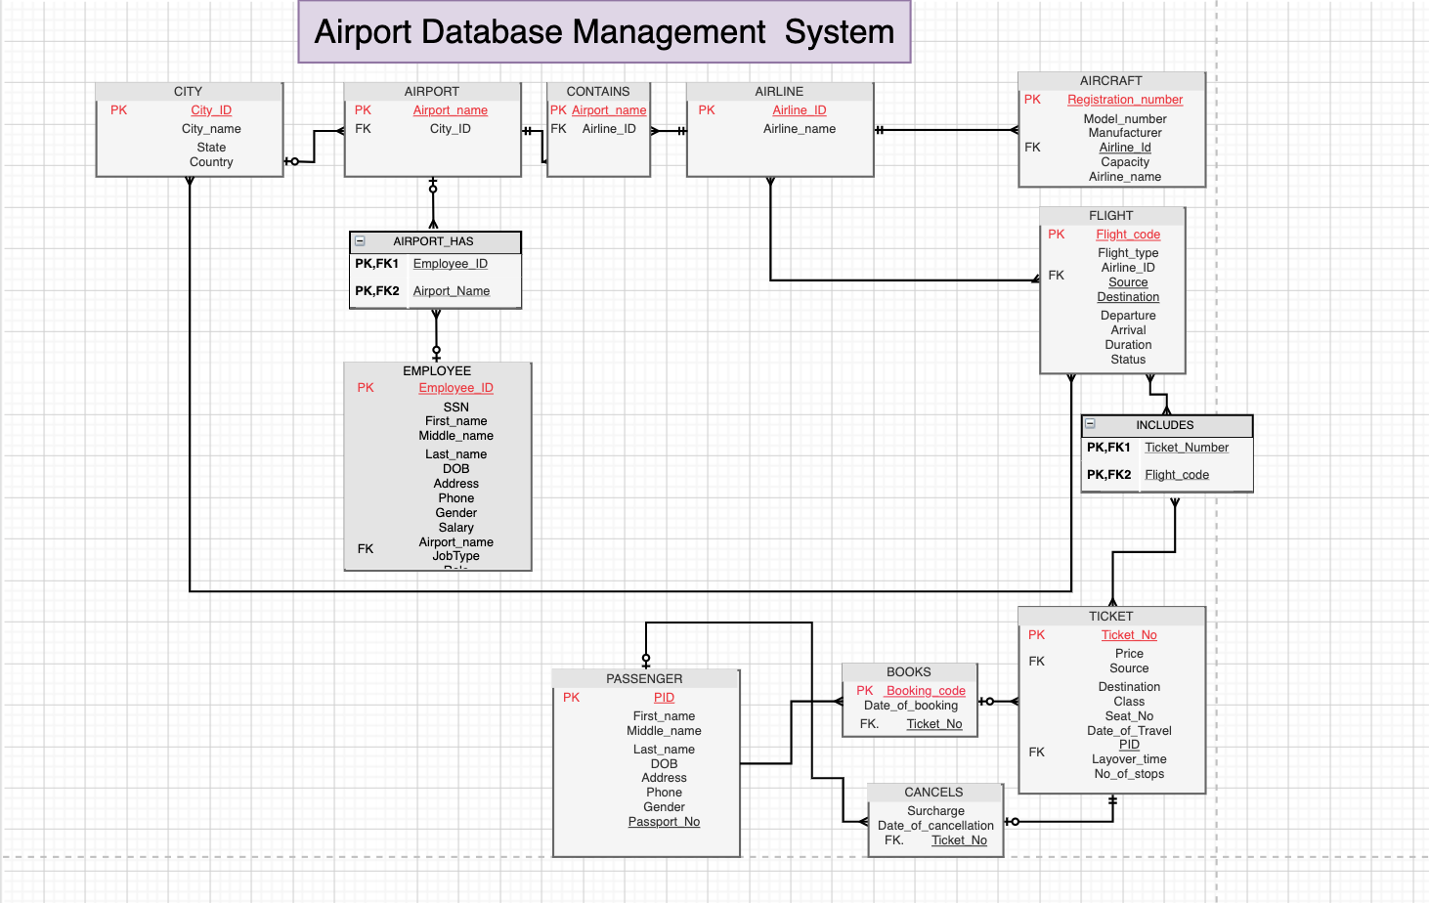
Final ERD

Slide 5
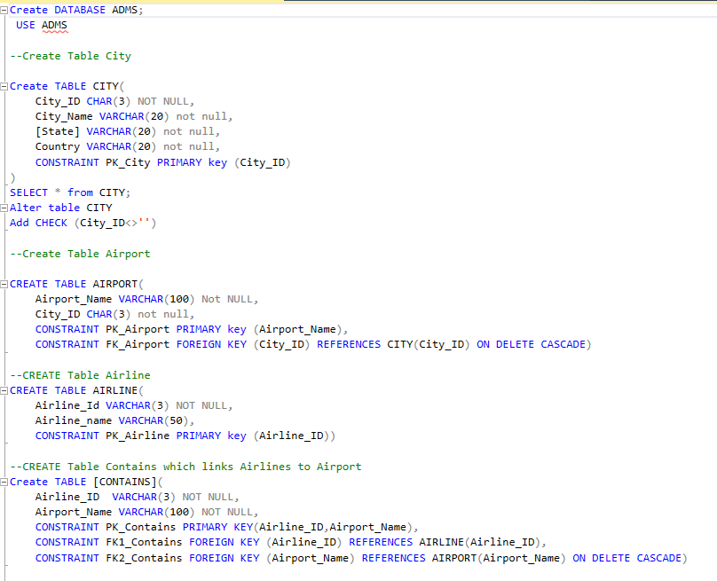
DDL Statements

Slide 6
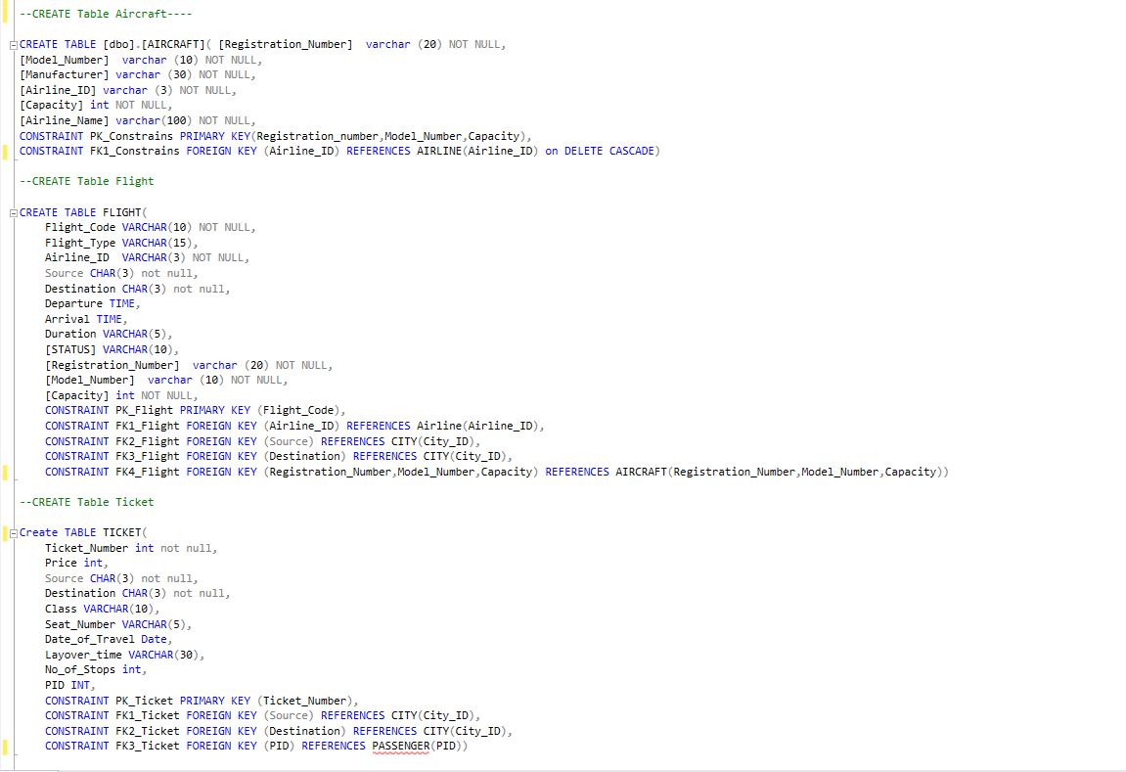

Slide 7
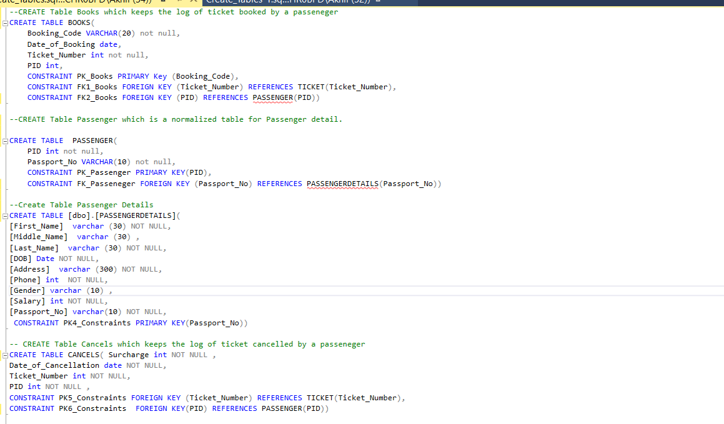

Slide 8
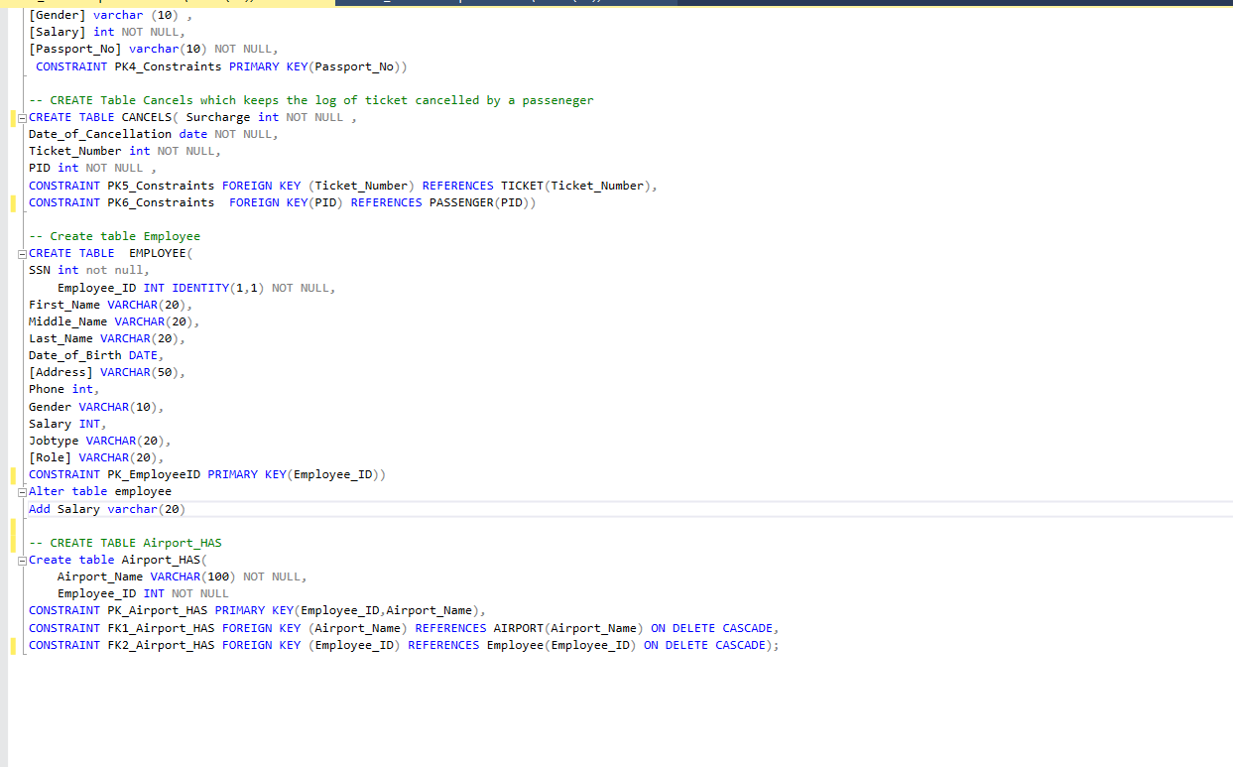

Slide 9
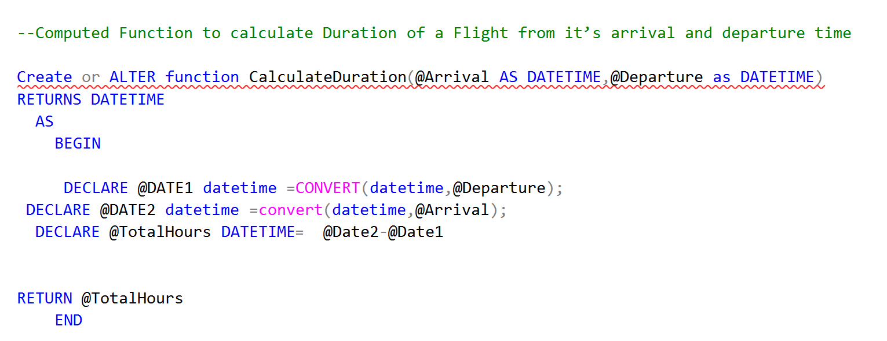
User Defined Function : Duration of Flight

Slide 10
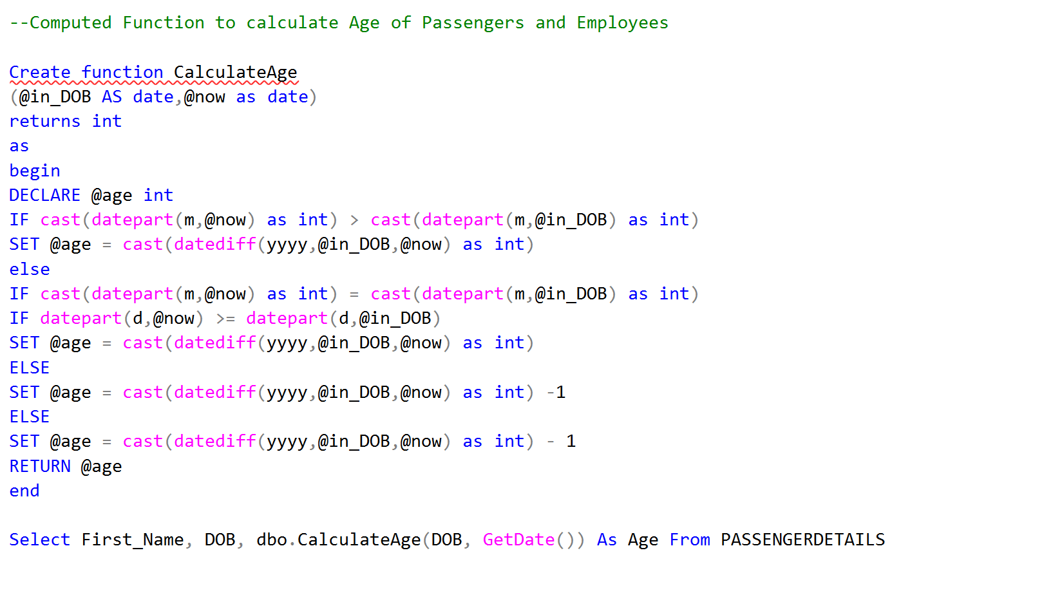
User Defined Function : Age of Passenger and Employees

Slide 11
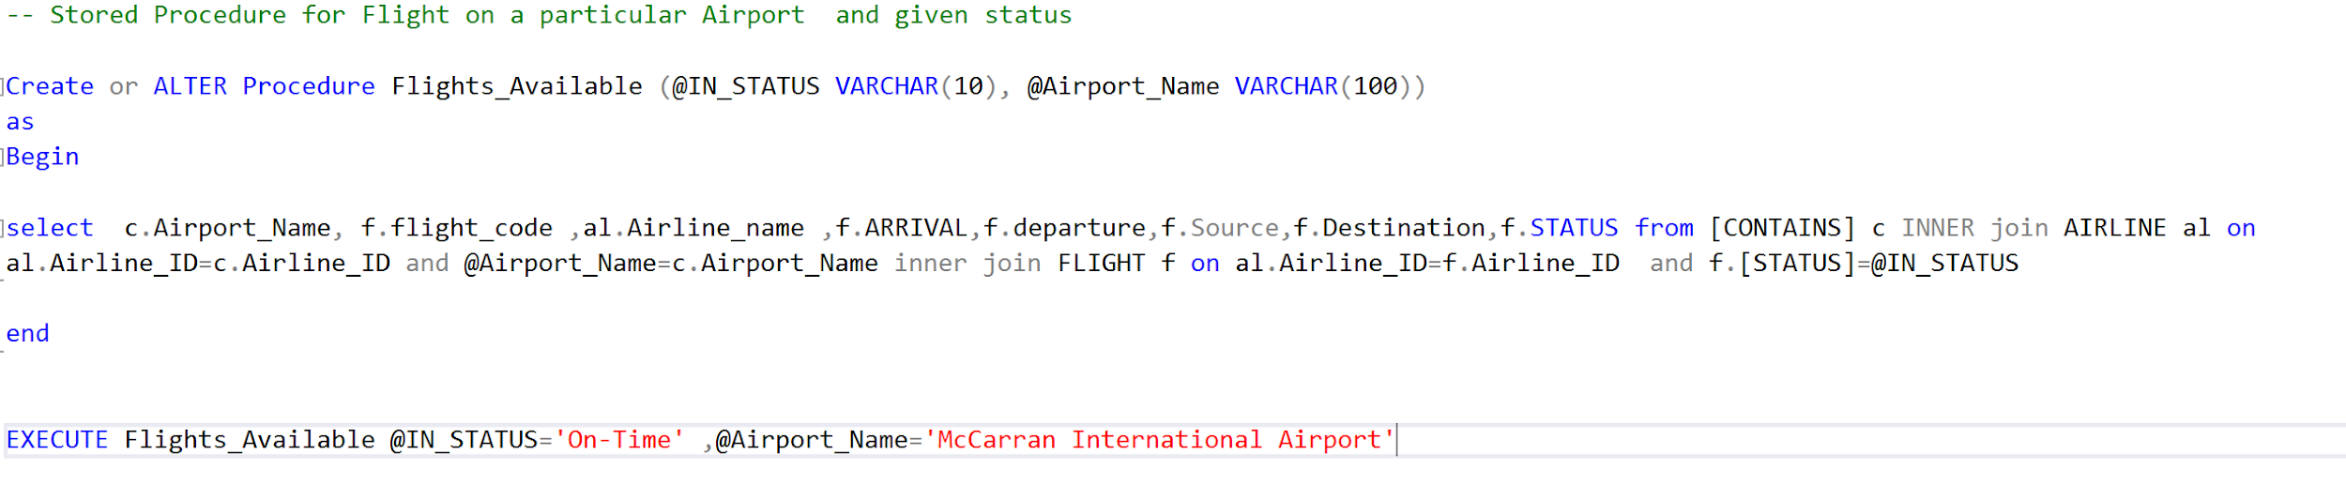
Stored Procedure : Available Flights by Status

Slide 12
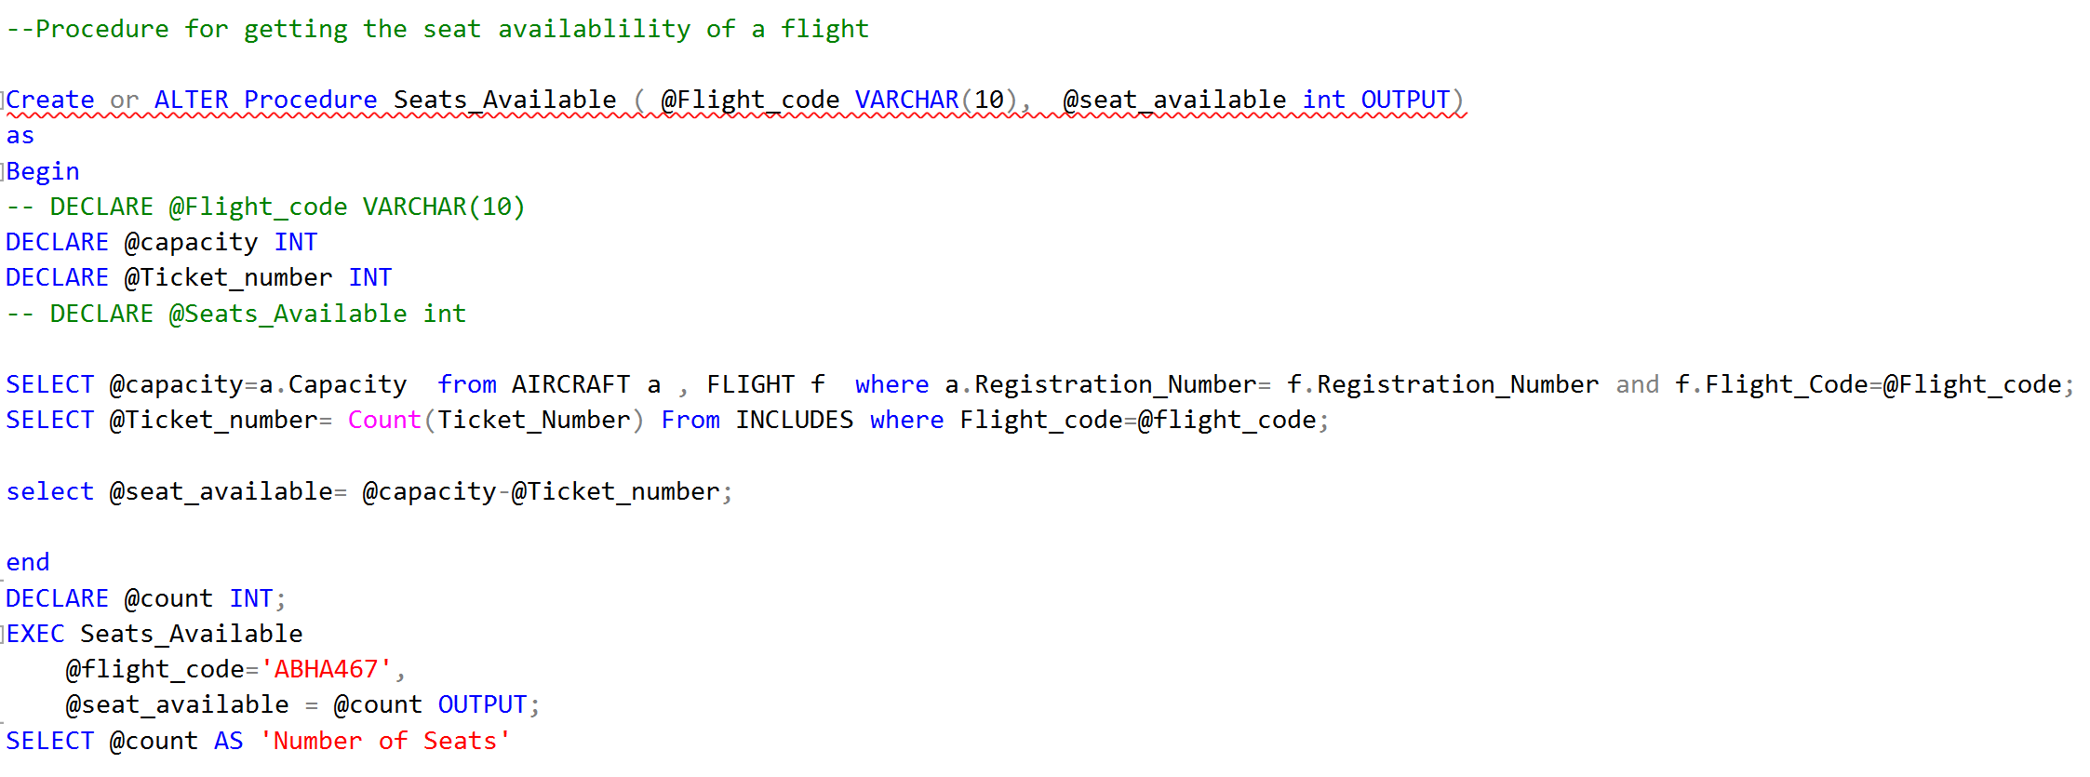
Stored Procedure : Getting the seat availability

Slide 13
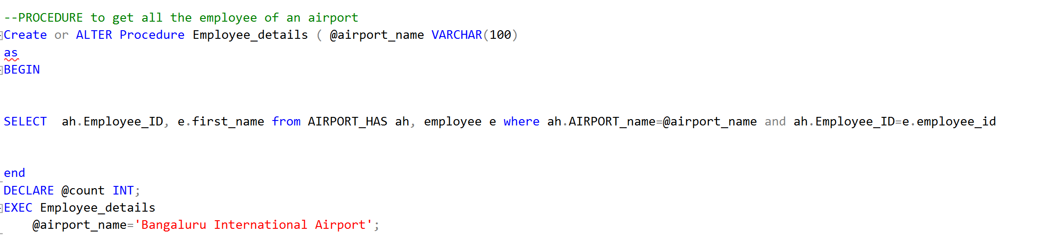
Stored Procedure : Employees in an airport

Slide 14
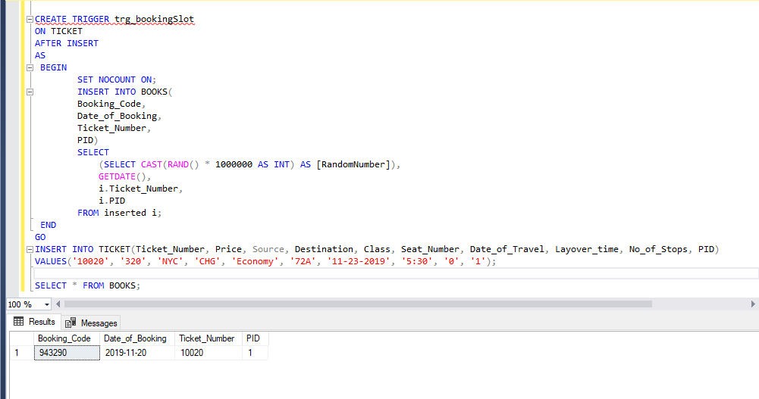
Use Case : Trigger for filling Book Table

Slide 15
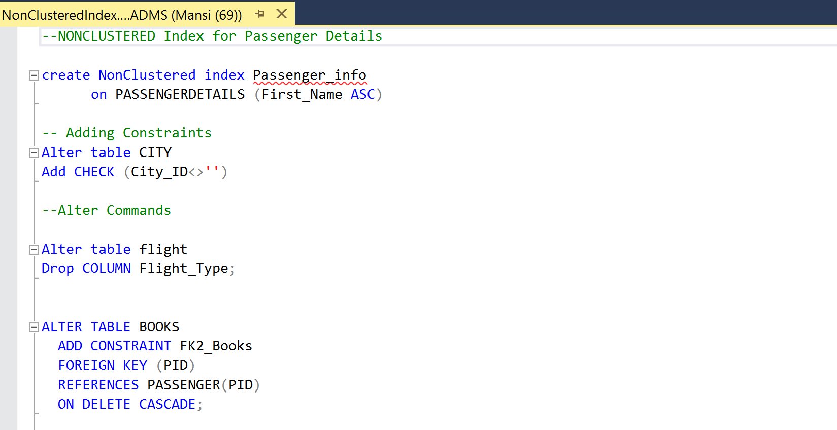
Non-Clustered Index

Slide 16
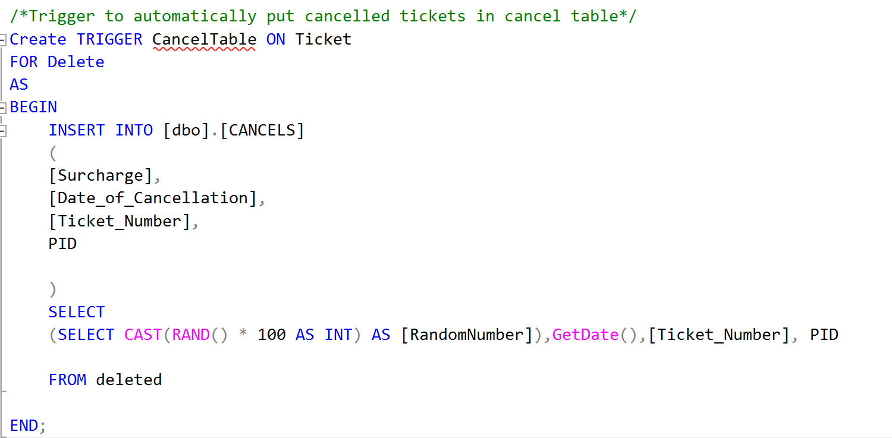
Trigger : Filling the cancel table with cancelled tickets

Slide 17
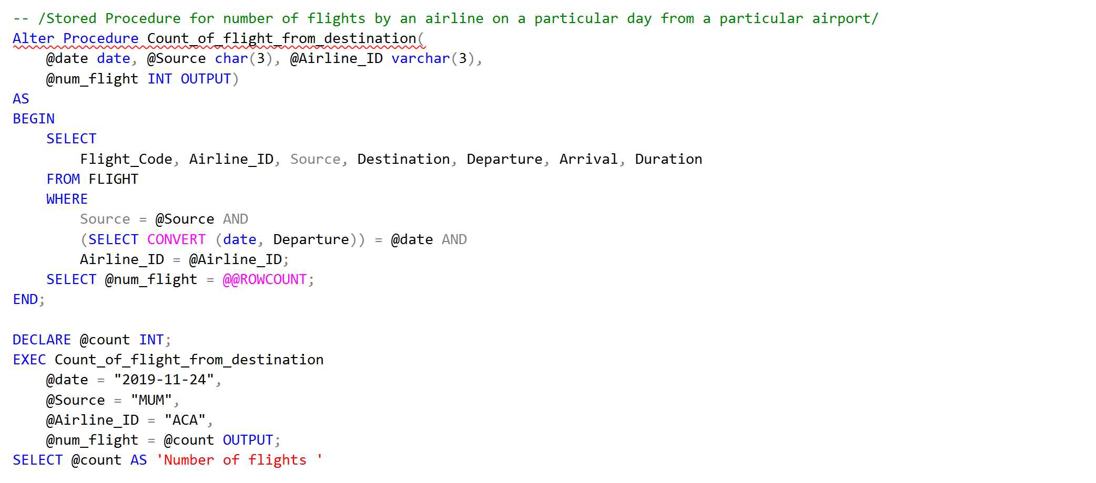
Stored Procedure : Count of Flights from a destination on a given date

Slide 18
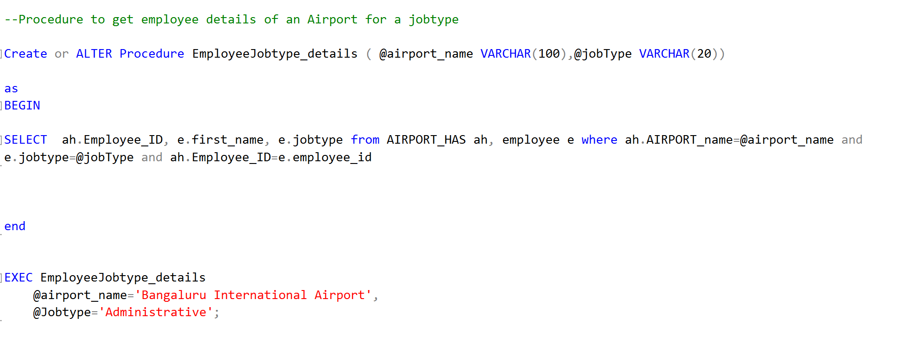
Stored Procedure : Employee details based on job type

Slide 19
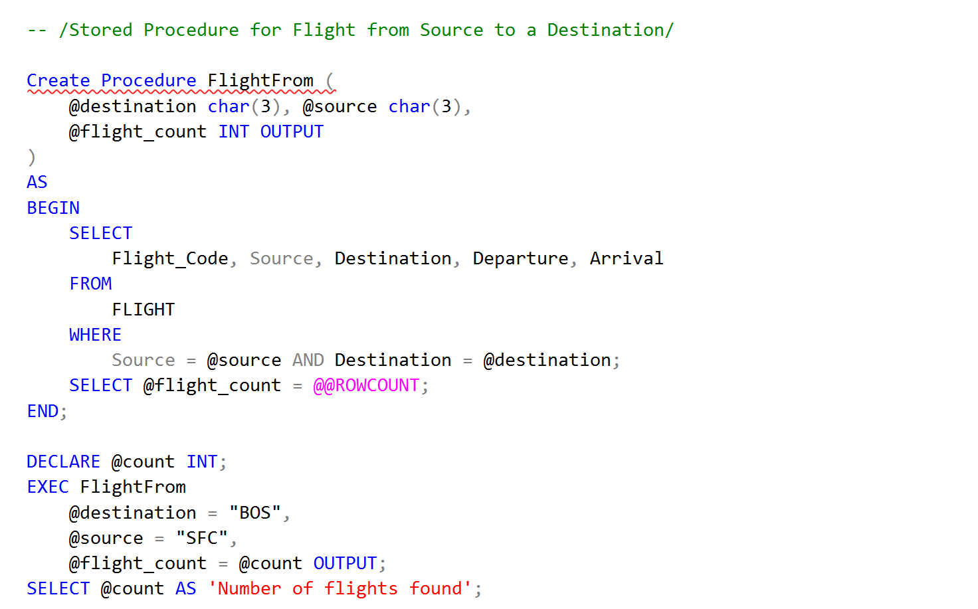
Stored Procedure : To search flight from a source to a destination

Slide 20
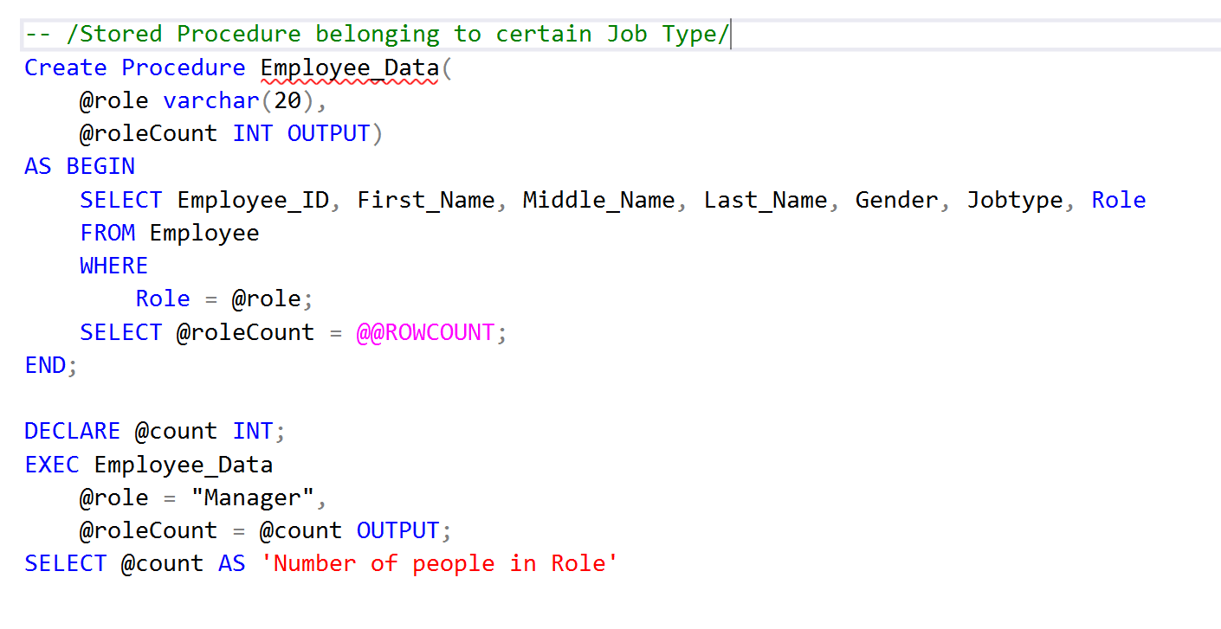
Stored Procedure : Getting count of employee based on job type

Slide 21
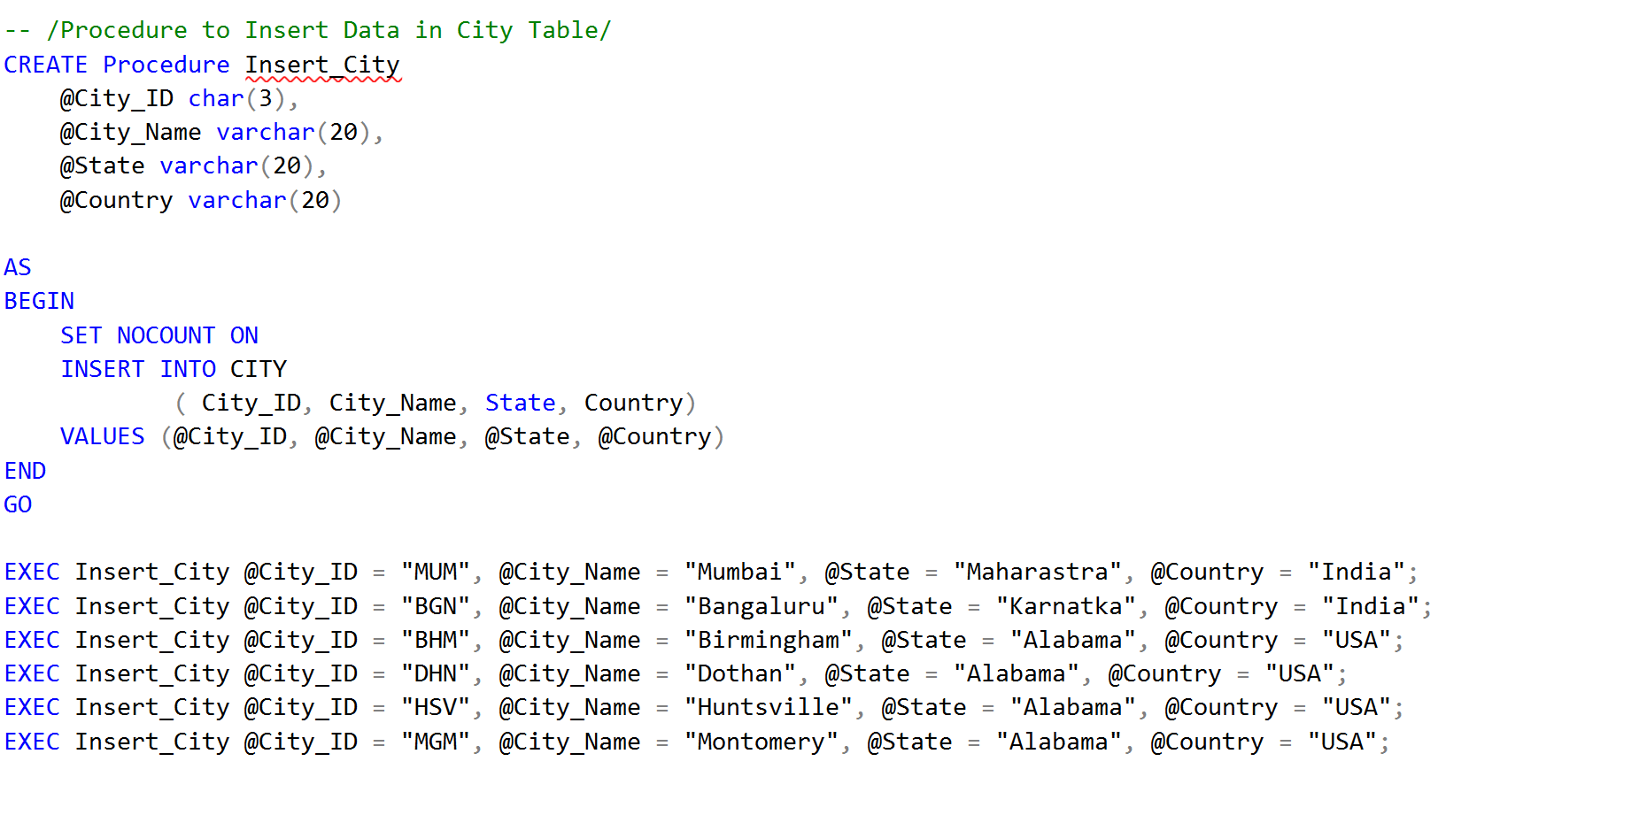
Stored Procedure : To insert data in City Table

Slide 22
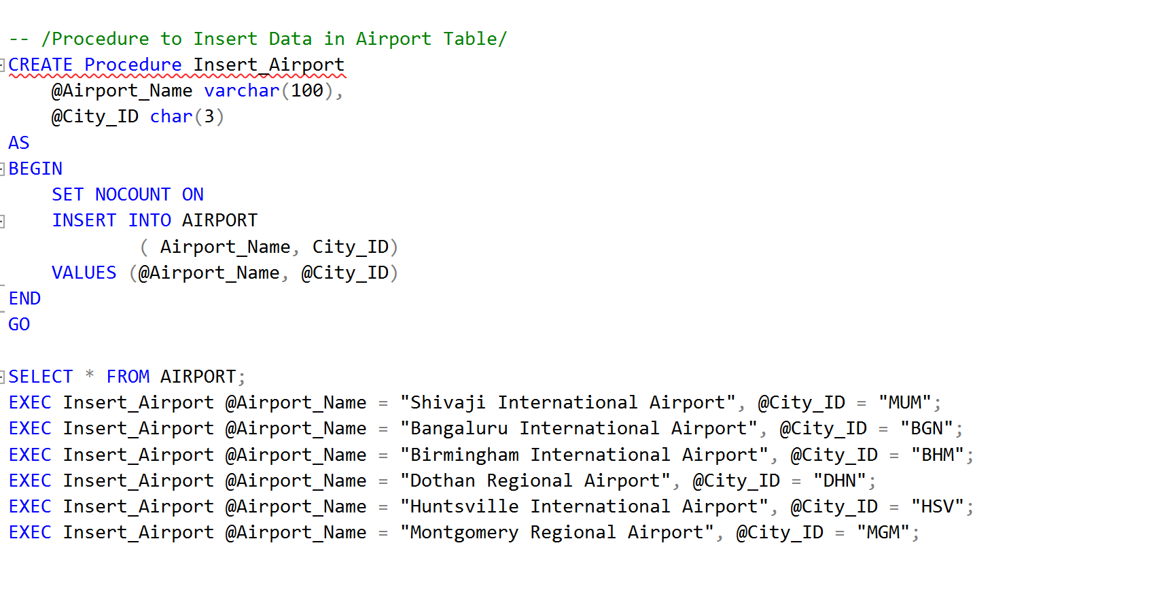
Stored Procedure : To insert Airport Data

Slide 23
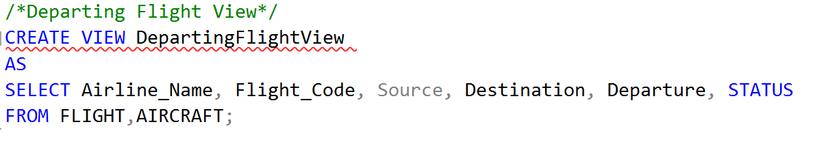
Views : Departing Flight View

Slide 24
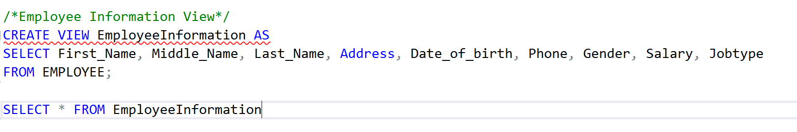
Views : Employee Information View

Slide 25
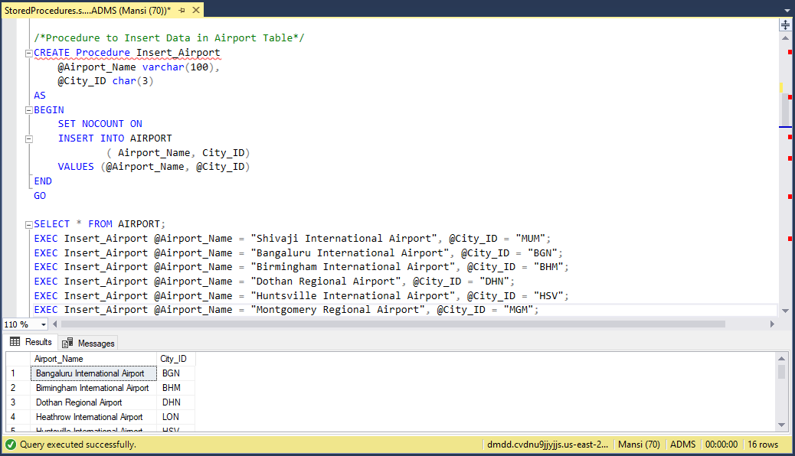
Use Cases : Stored Procedure to Insert Data

Slide 26
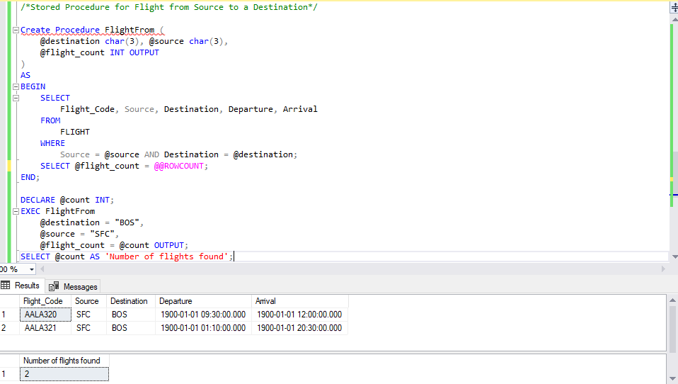
Use Case : Stored Procedure for Flight from a Source

Slide 27
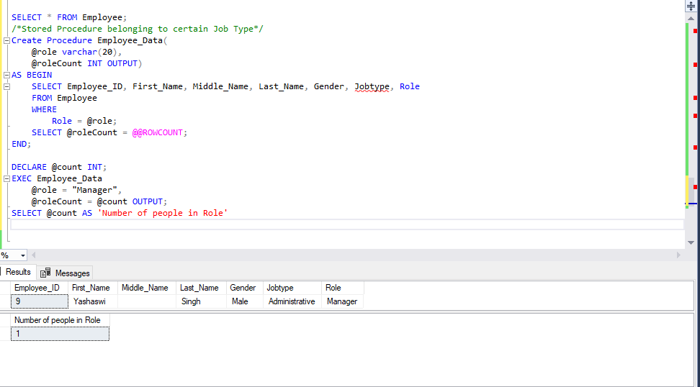
Use Case : Stored Procedure for getting Employee by Job Type

Slide 28
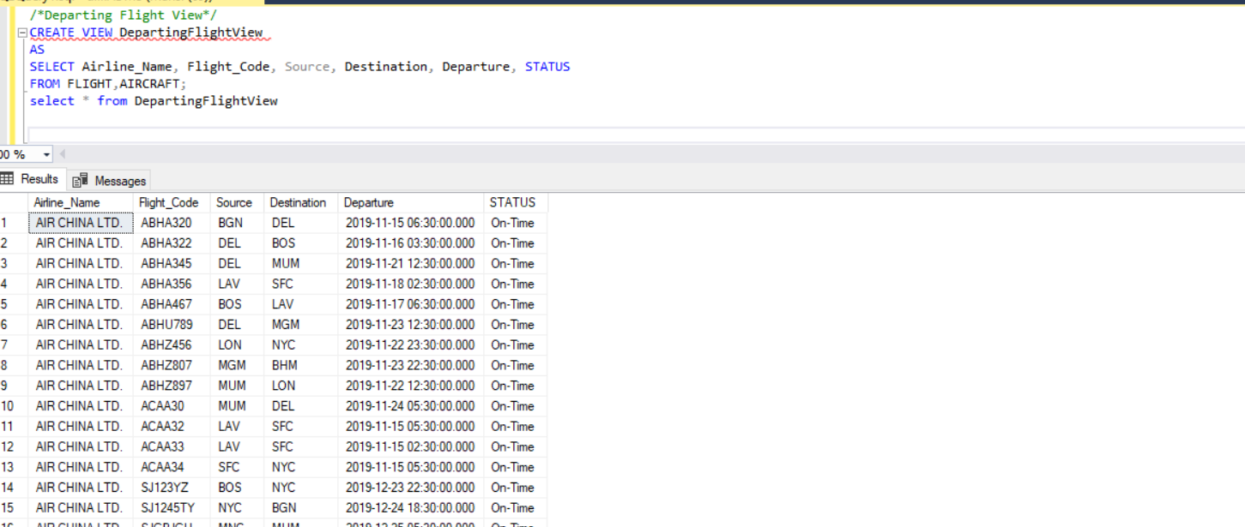
Use Case : View for Departing Flight Details

Slide 29
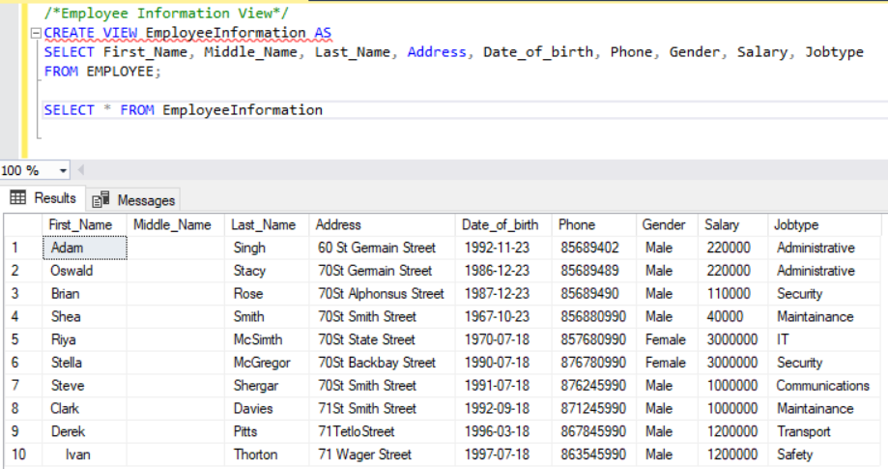
Use Case : Views for Employee Information

Slide 30
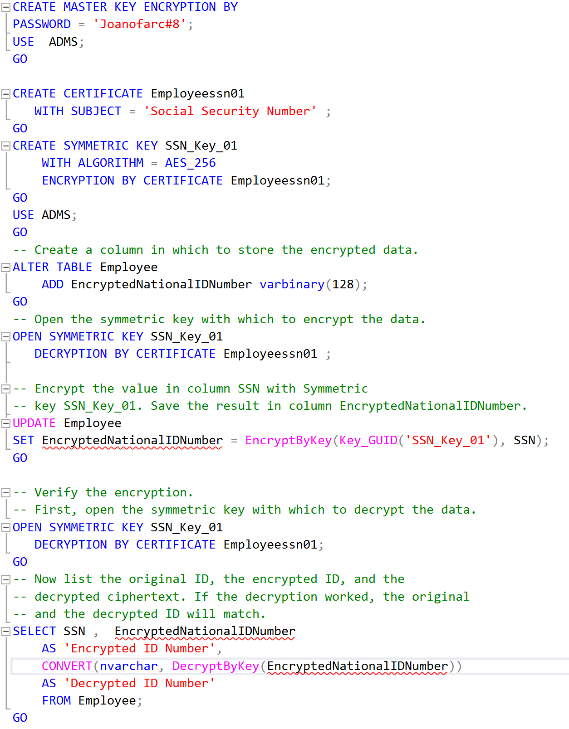
Encryption : Column Encryption on Employee Table

Slide 31
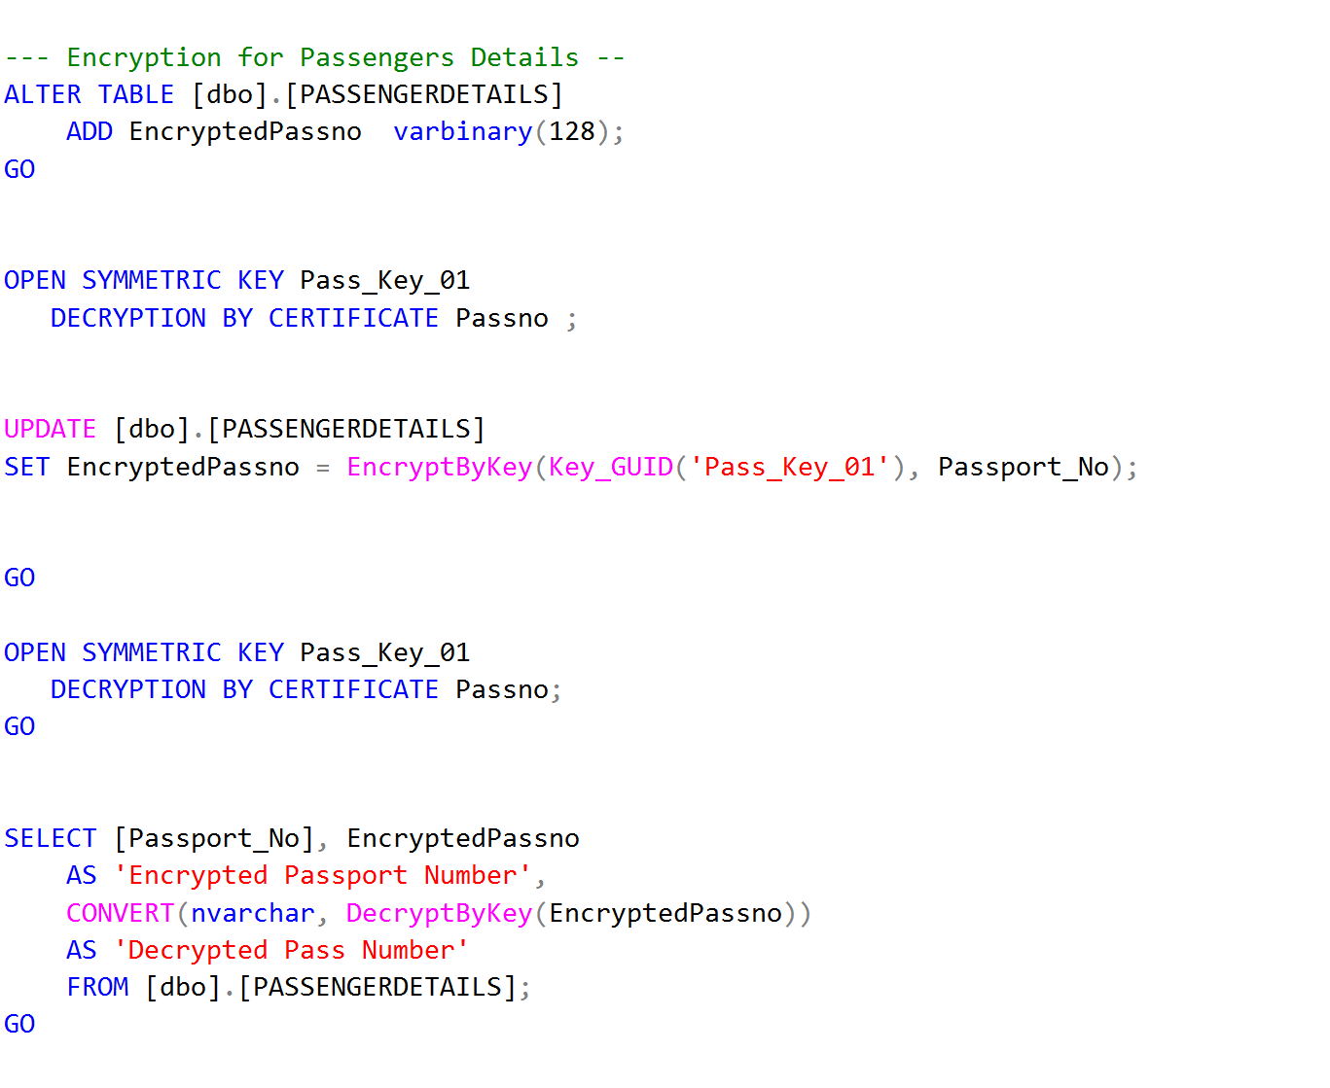
Encryption : Column Encryption on

Slide 32
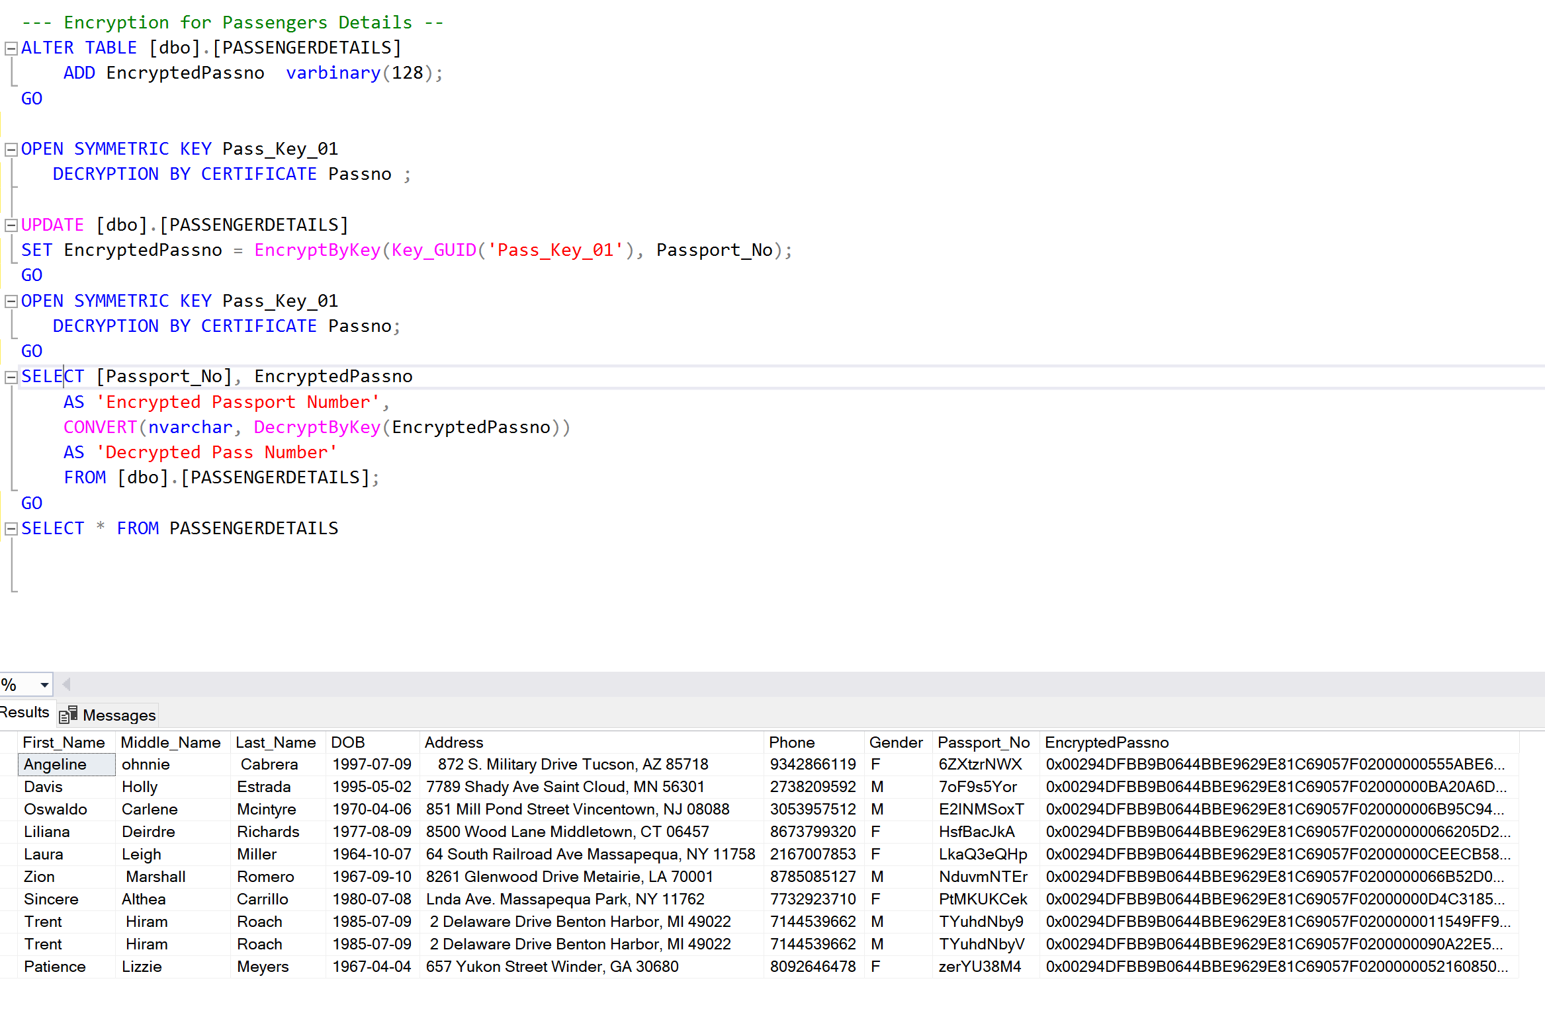
Use Cases : Encryption

Slide 33


Slide 34
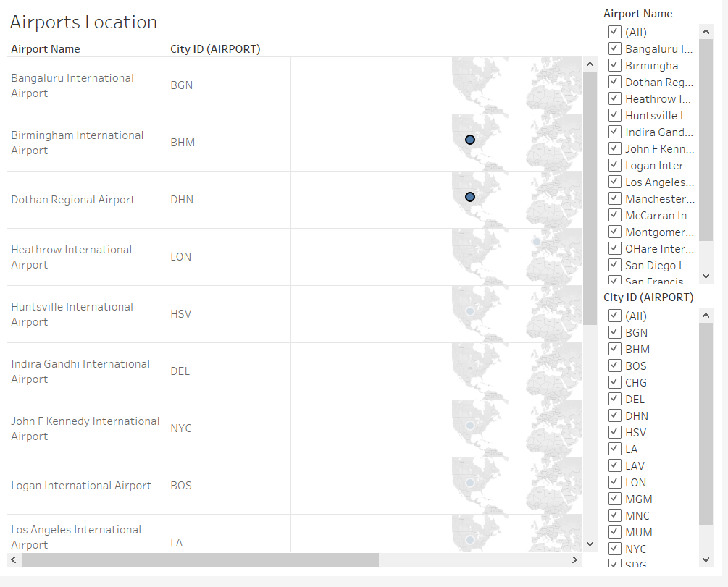

Slide 35
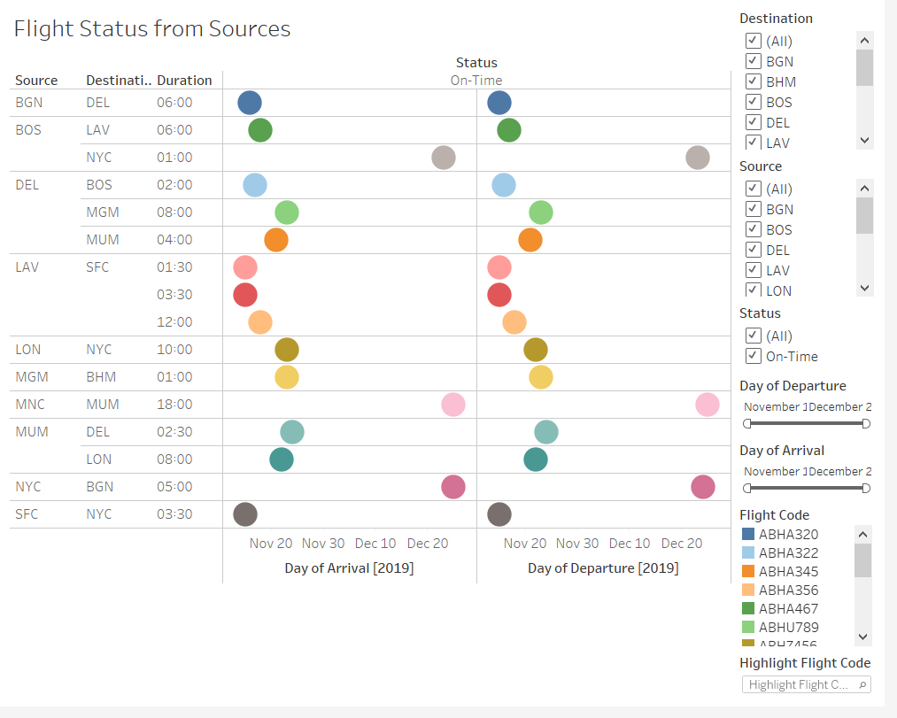

Slide 36
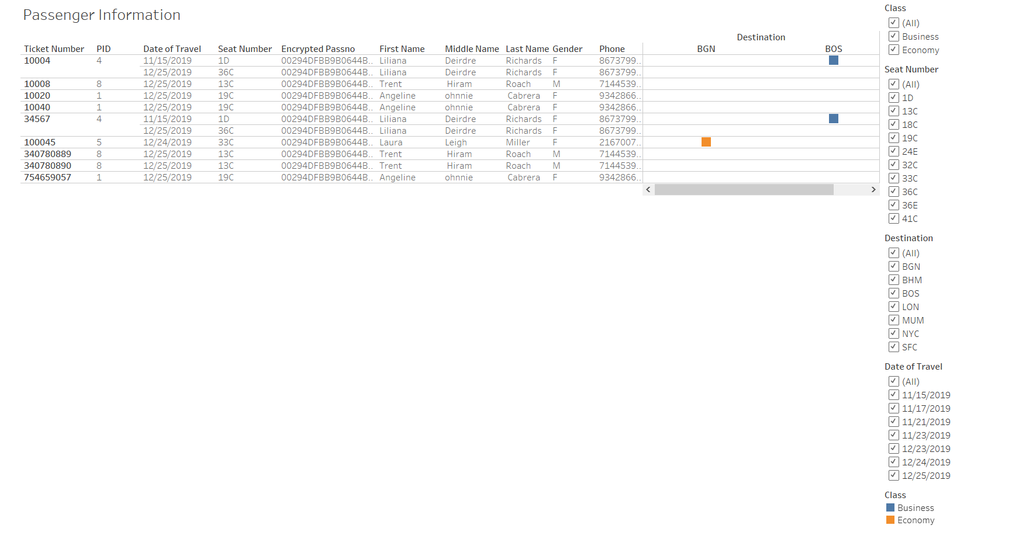

Slide 37
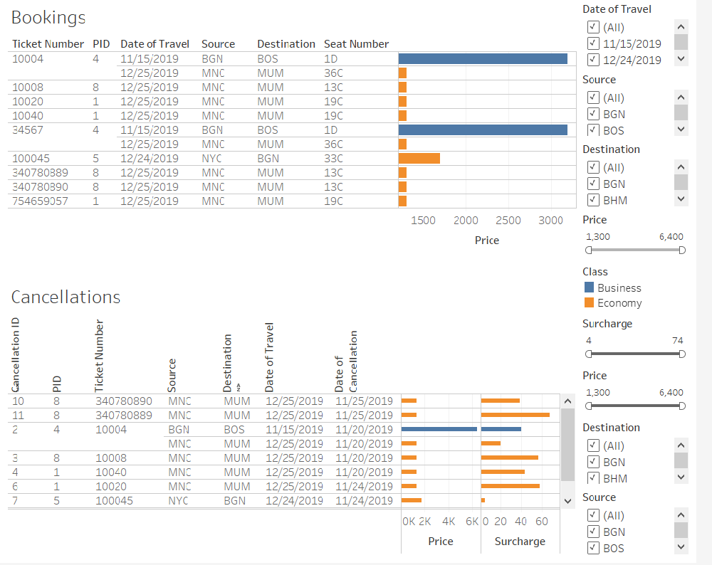

Slide 38
